Slide 1






DDSANALYTIC TALENT MANAGEMENT SOLUTION
Kris Ghimire

Slide 2



leverage data science
identify factors
TURNOVER
INTERESTING TREND
MODEL
CLASSIFICATION
PREDICTION

Slide 3


ATTRITION FACTORS
EMPLOYEE RETENTION
1
Marital Status
2
Income
3
Over Time
4
Stock Option
5
Job Involvement

Slide 4


ATTRITION
High attrition among single employee
MARITAL STATUS
4

Slide 5

ATTRITION
INCOME ANALYSIS
Job Hopper – Low wage employee
5

Slide 6
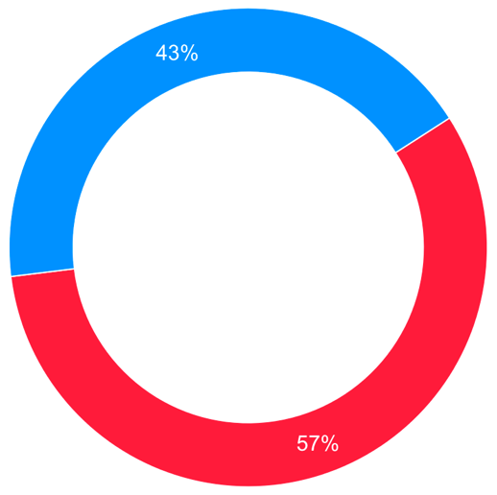
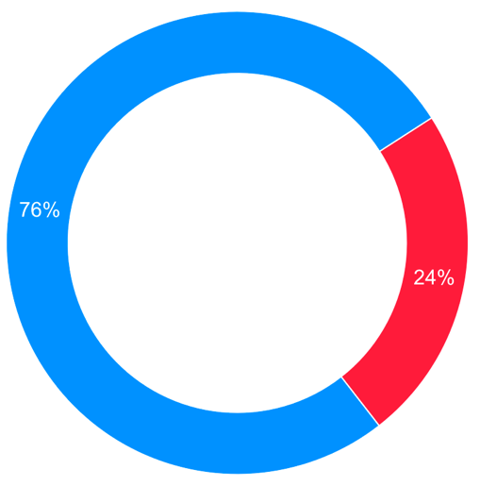



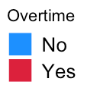


ATTRITION
Overtime Vs Attrition
Overtime Vs Attrition
YES
NO
Reduction in performance
Health and Stress
Turnover
OVERTIME
6

Slide 7

ATTRITION
STOCK OPTION
Could delay turnover
7
Notes:
A stock option gives an employee the right to buy a certain number of shares in the company at a fixed price for a certain number of years.

Slide 8
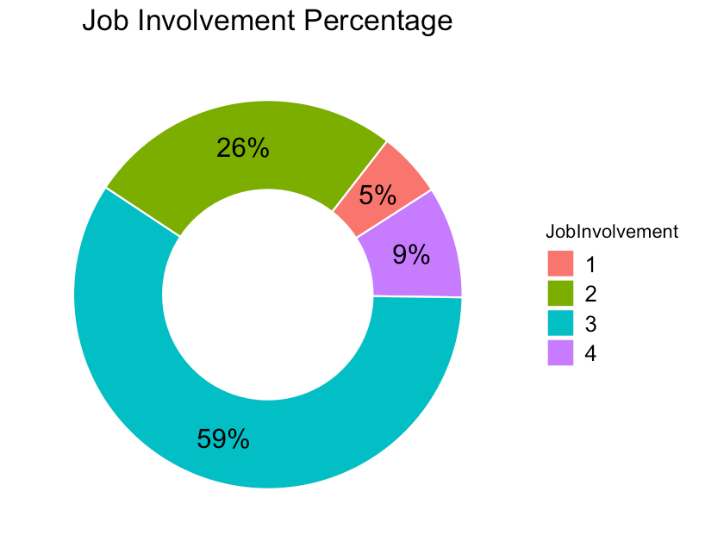


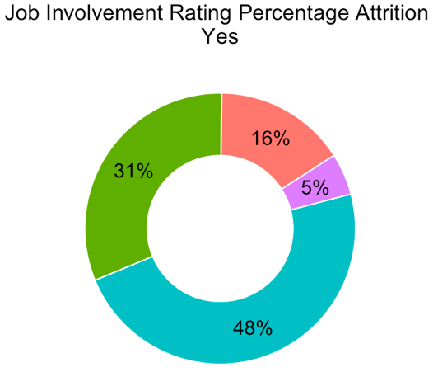
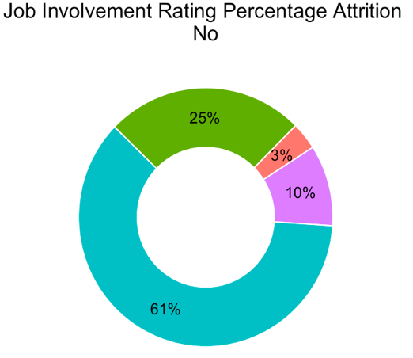

ATTRITION
Makes employee valued
Improves decision capability
Create bond among coworkers
Motivation
Lower attrition among engaged employees
JOB INVOLVEMENT
8
Notes:
The direct participation of staff to help an organization fulfill its mission and meet its objectives by applying their own ideas, expertise, and efforts towards solving problems and making decisions.

Slide 9



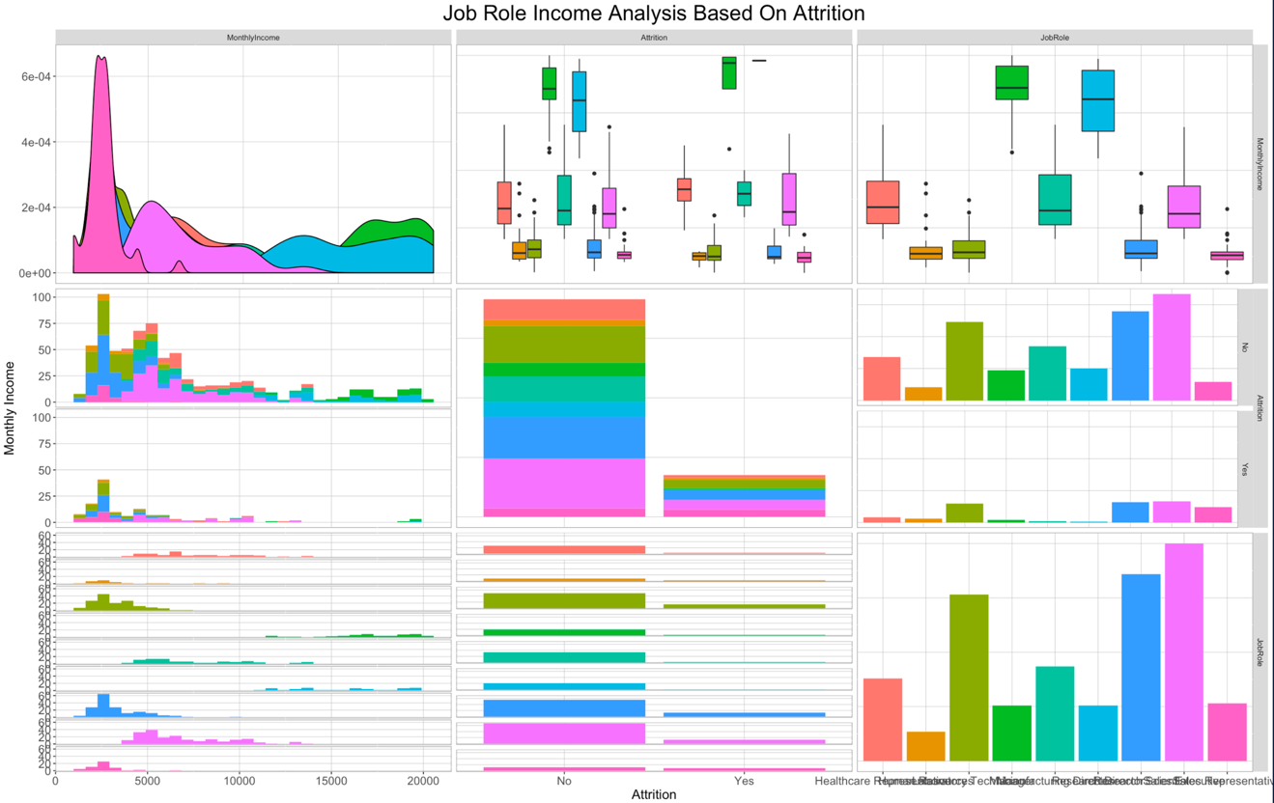

ATTRITION
Income Analysis
9

Slide 10



SATISFACTION
Happy with the company
Sales Executive- Most Satisfied also higher in number
10

Slide 11



INTERESTING TREND
Majority of Employee Between 25-35 Years
Just One Employee around 60
Fairly New to the Company
Sale Executive the dominating number
11

Slide 12

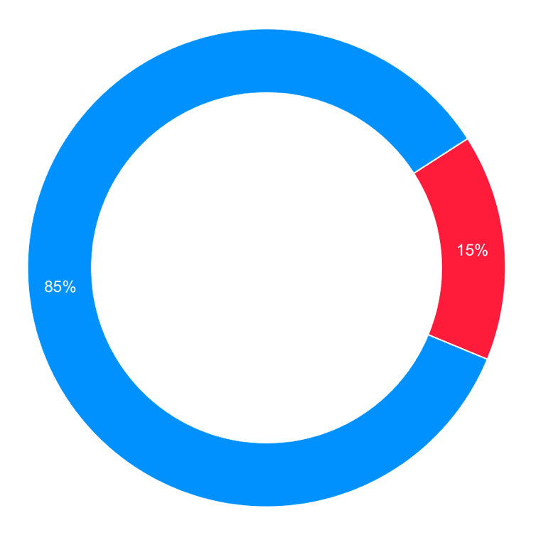
Naive Bayes Attrition Classification
Sensitivity : 91%
Specificity : 76%
Attrition No
Attrition Yes
Accuracy = 83%
12

Slide 13
Linear Regression Income Prediction
RMSE = 1340
Adjusted R-squared: 0.9184
13

Slide 14

CONCLUSION
Focus on employee engagement
Make stock option available.
Reduce over time

Slide 15





THANK YOU!
Kris Ghimire
kghimire@gmail.com
678-555-0100

Slide 16
GitHub Link:
https://github.com/krisGTech/DDS_FINAL_PROJECT

